Slide 1


Slide 2
Hospital Management System
Group Members
Shahzad BABAR

Slide 3
Agenda Style
01
Problem Statement
Problem Identification & Solution
02
Objectives
Purpose/Motivation to Built
03
Flow Diagram
Flow Process Diagram
04
Pseudo Code
Pseudo code
05
Output Display
Screenshots

Slide 4
Problem Statement
Chapter#1

Slide 5
Problem Statement
Problem Identification:
Manual Calculations are error prone & consumes a lot of time.
Adopted Methodology
To minimize human effort & increase the efficiency, we propose this hospital
management system based on Database concepts using MS ACCESS.

Slide 6
Why MS Access
Why we used MS ACCESS
As we are dealing with offline database system so we are using MS Access to
create forms , apply queries & relationships.
Future Scope
The successful implementation of this concept can be implemented by using
Php & Microsoft.NET for more efficient database system that have proper backend as well as front end

Slide 7
Objectives
Chapter#2

Slide 8
Objective
To minimize the time complexity.
To provide all facilities at a single site .
To make the records safe and organized.
To keep data save in soft form.

Slide 9
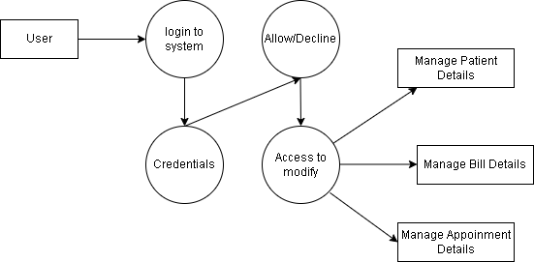
Flow Process Diagram

Slide 10
Pseudo Code
Open the database and fill the credentials.
The software will match the username & password query given in database.
If the credentials don’t match an error will be displayed.
Click on add button to add patient details in existing database.
Click on database button to search the patient details.
Click on schedule button to check appointment details.
Click on analytics to view the analytical structure of database.
Click on exit button to exit the database.

Slide 11
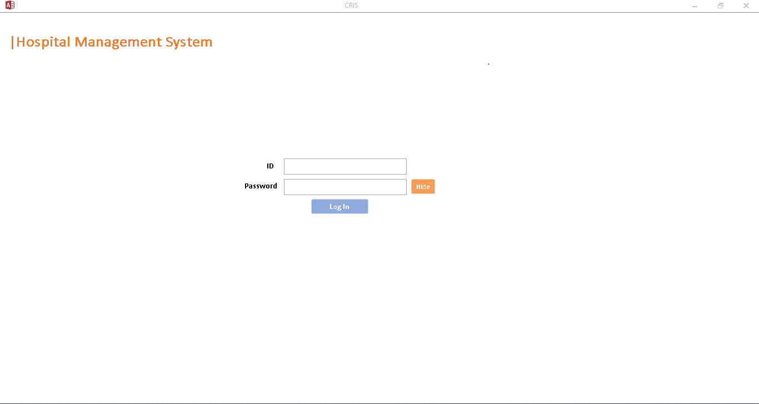
Login Page

Slide 12
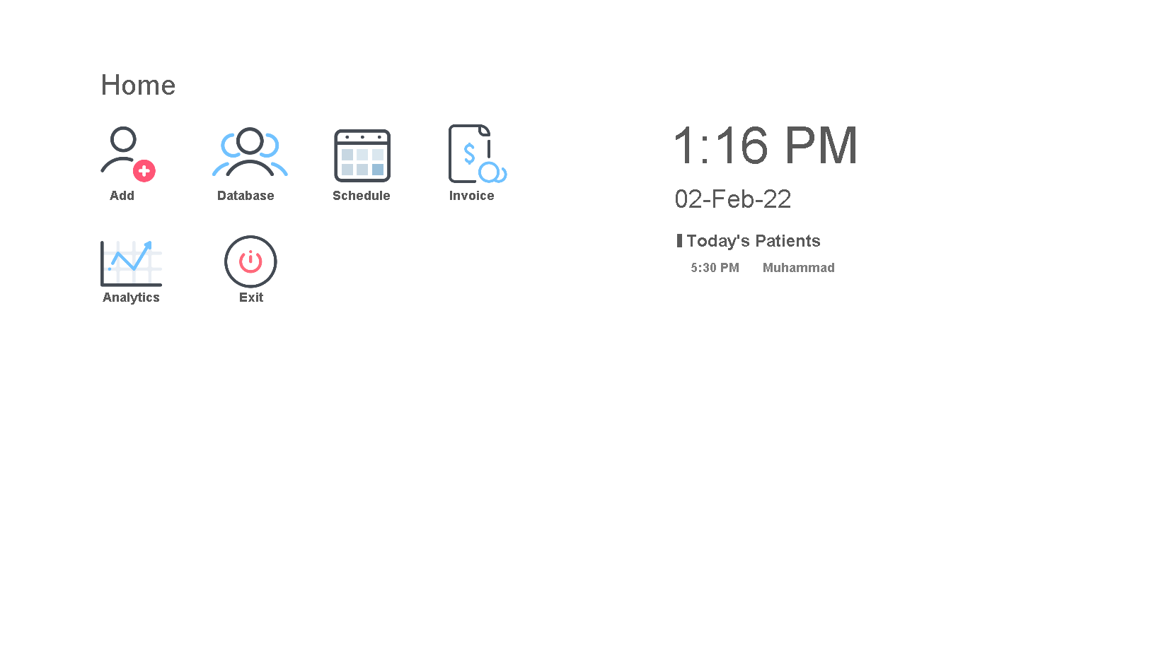
Homepage

Slide 13
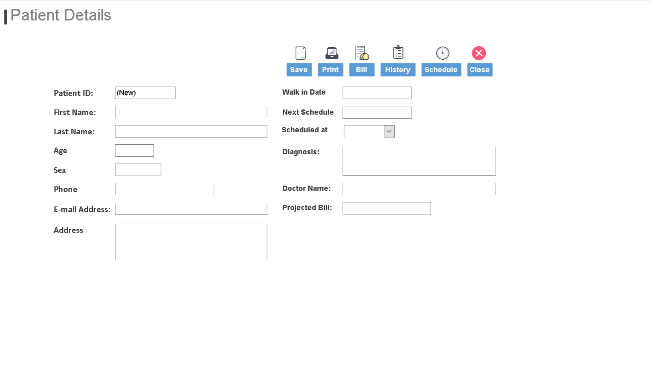
Patient Details

Slide 14
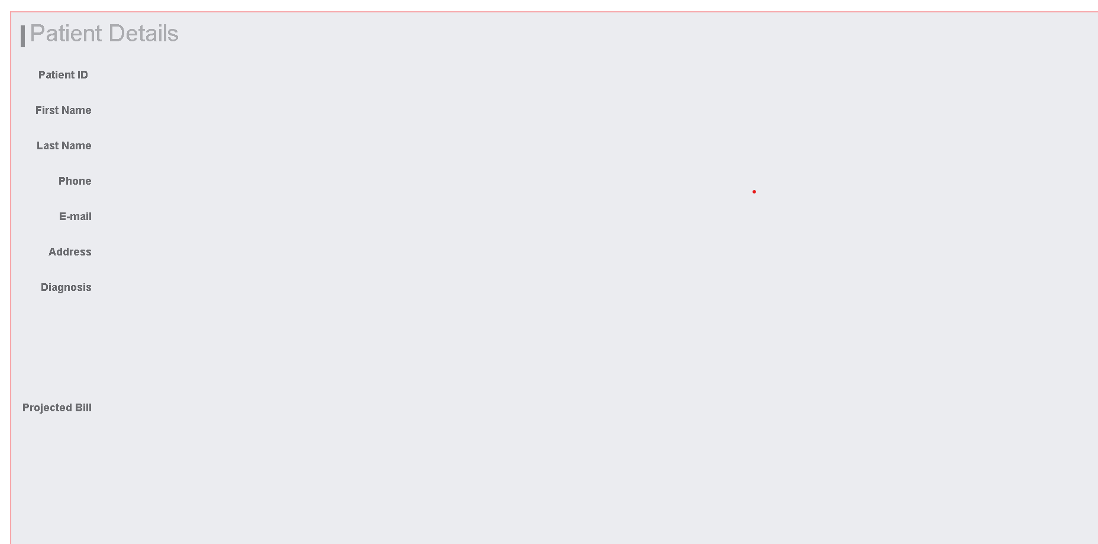
Patient Details

Slide 15
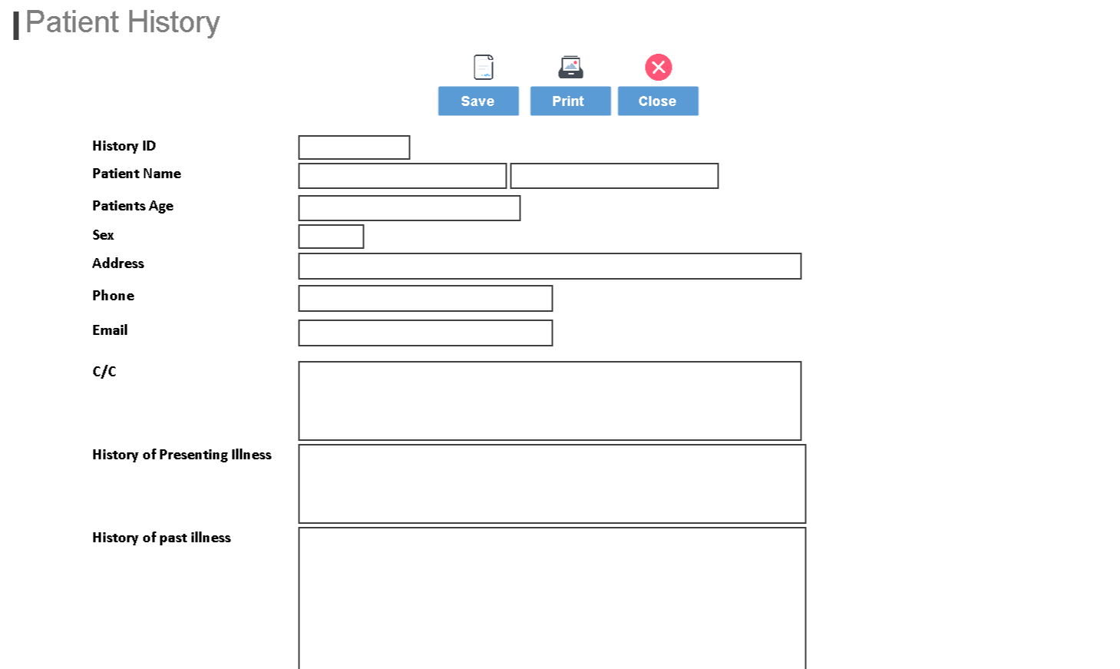

Slide 16
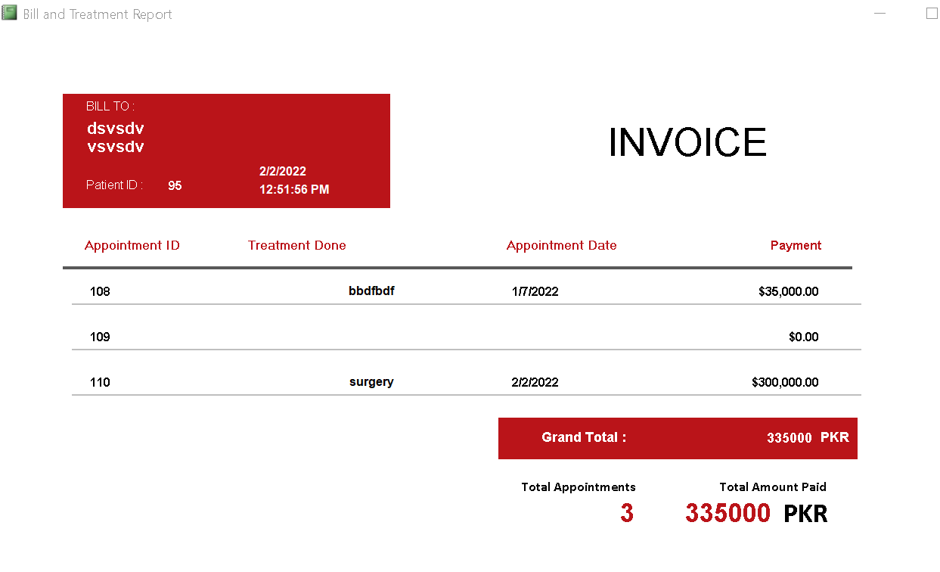
Invoice Detail

Slide 17
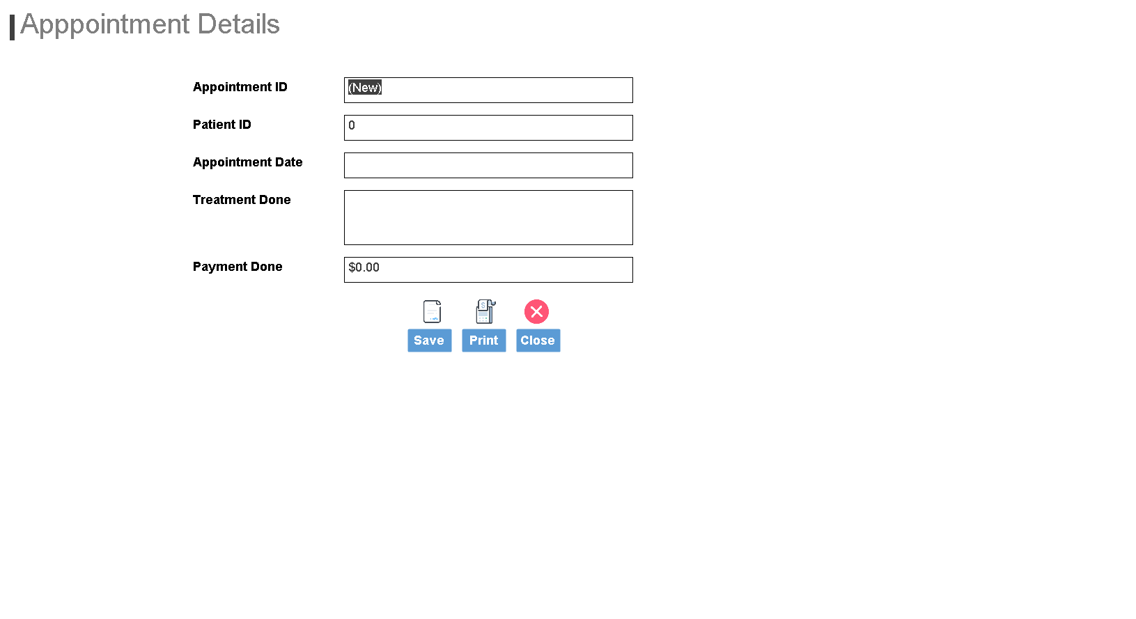
Appointment Detail

Slide 18
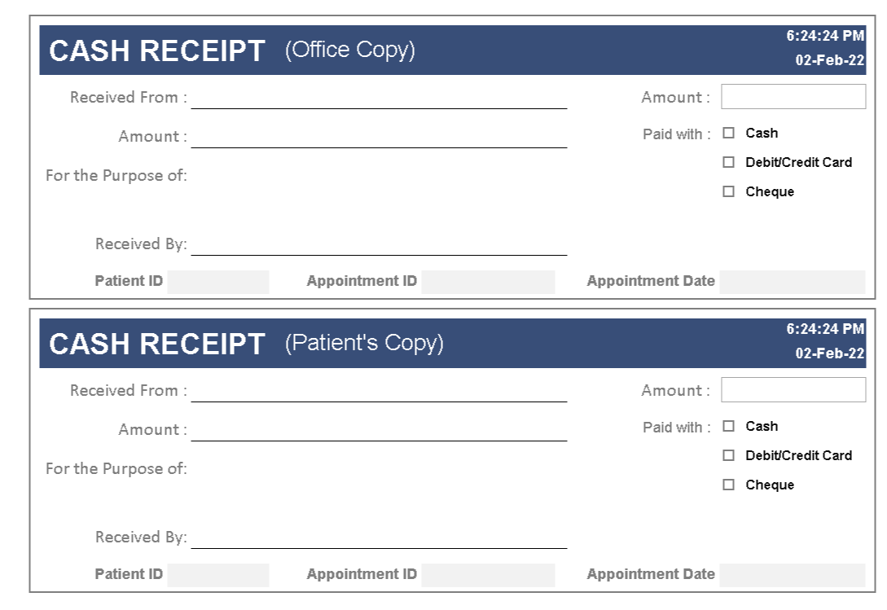
Appointment Slip

Slide 19
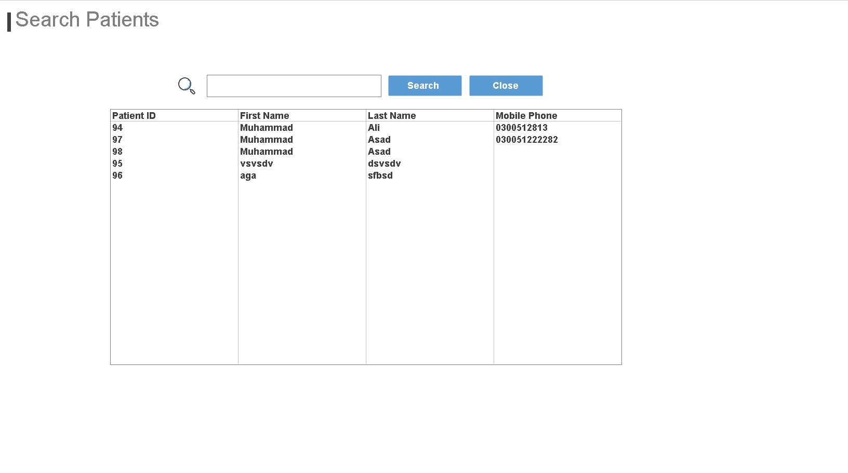
Patient Database

Slide 20
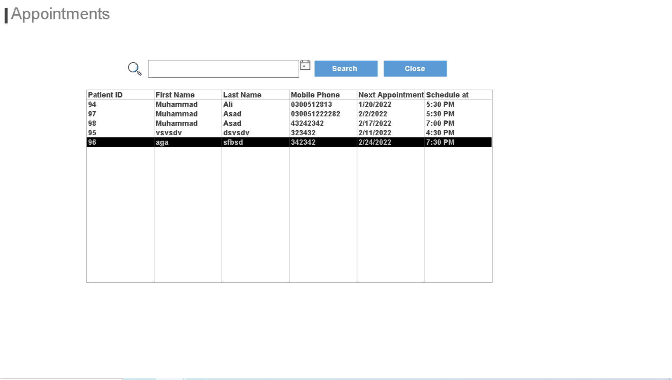
Appointment Details

Slide 21
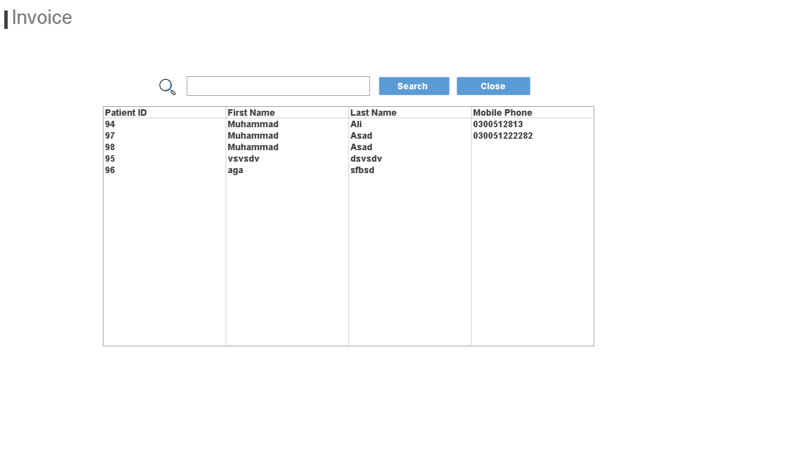
Invoice Details

Slide 22
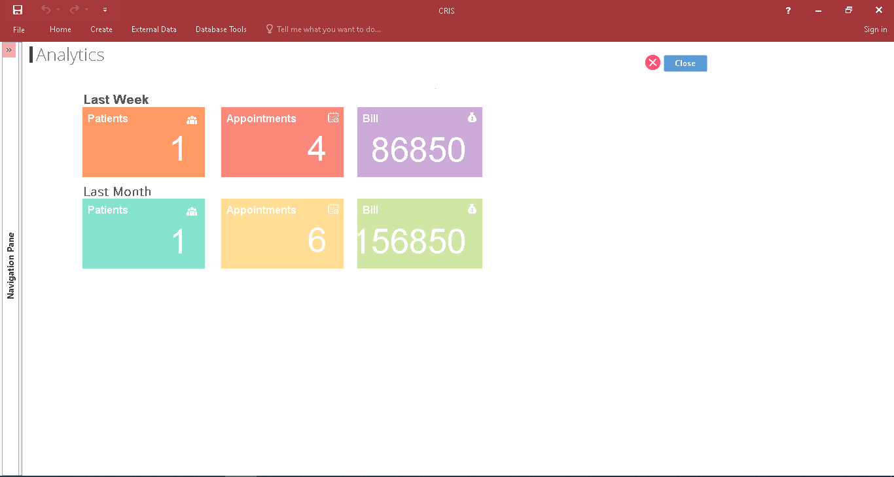
Hospital Analytics

Slide 23
Thank you
Thankyou for your precious time & attention

Slide 24
Any Question!!

